Slide 1
Casting Methods: Die Casting
Centrifugal Casting
Lecture 6

Slide 2
Hot Chamber die casting
Good for low temperature (approx. 650°C)
Faster than cold chamber machines
Cycle times must be short to minimize metal contamination
Metal starts in a heated cylinder
A piston forces metal into the die
The piston retracts, and draws metal in
Metal: Lead, Tin, Zinc

Slide 3
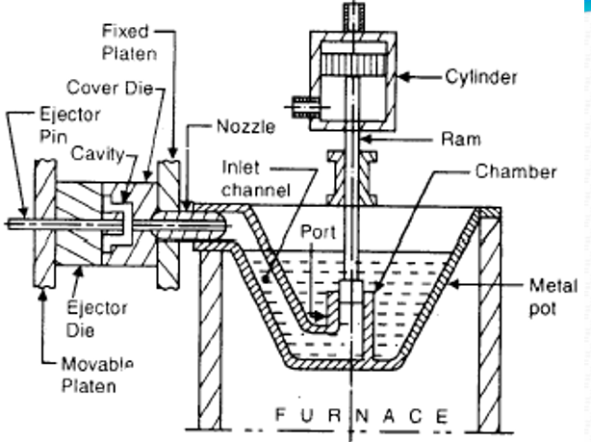
Hot Chamber die casting

Slide 4
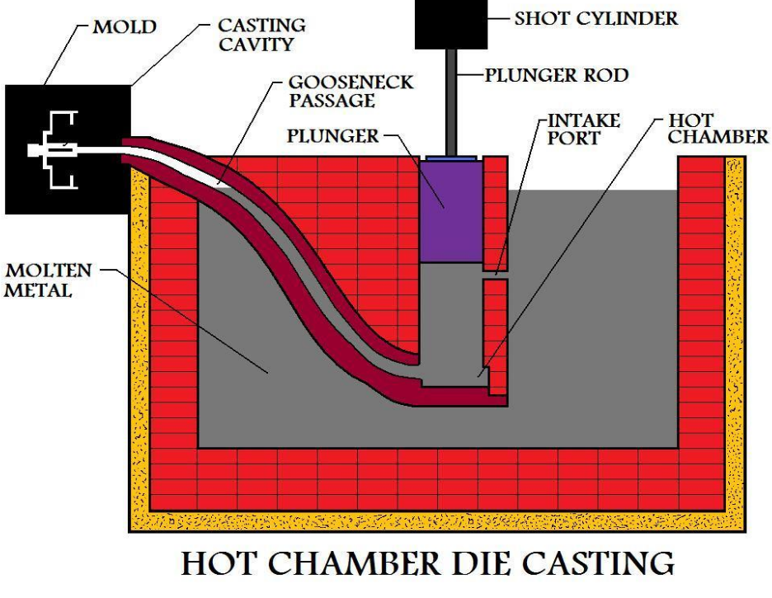
Hot Chamber die casting

Slide 5
Cold Chamber die casting
Casts high melting point metals ( > 700°C)
High pressures used
Metal is heated in a separate crucible
Metal is ladled into a cold chamber
The metal is rapidly forced into the mold before it cools
Copper, Brass and Aluminum can cast.

Slide 6
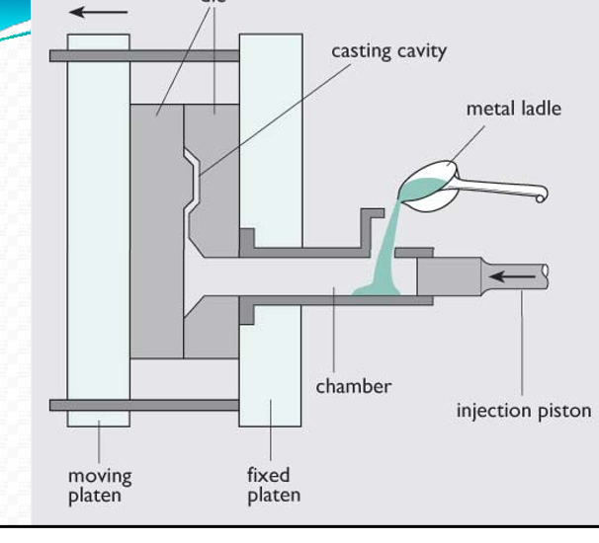
Cold Chamber die casting

Slide 7
Cold Chamber die casting
Extremely smooth surfaces (1 µm)
Excellent dimensional accuracy
Rapid production rate
Better mechanical properties compared to sand casting
Intricate parts possible

Slide 8
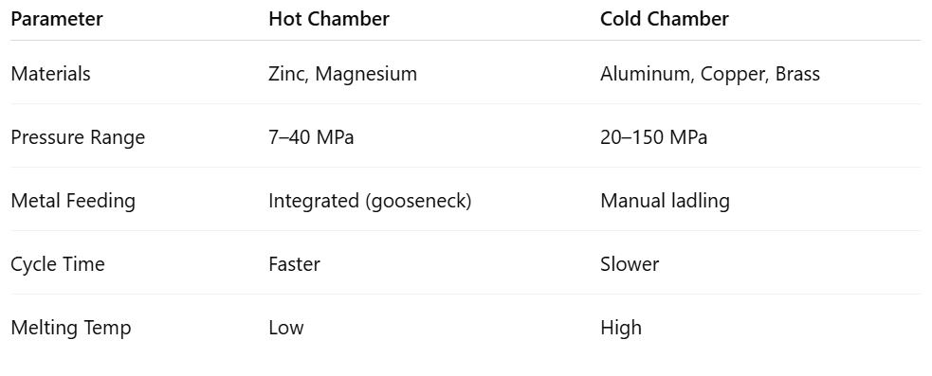
Summary Table for Hot and Cold Chamber die casting

Slide 9
Die casting
High initial die cost
Limited to high‐fluidity nonferrous metals
Part size is limited
Porosity may be a problem
Some scrap in sprues, runners, and flash, but this can be directly recycled

Slide 10
Die casting
Applications
Carburetors
Automotive parts
Bathroom fixtures
Toys
Common metals
Alloys of aluminum, zinc, magnesium, and lead Also possible with alloys of copper and tin.

Slide 11
Centrifugal casting
Centrifugal casting is a metal casting process that utilizes centrifugal force to distribute molten metal into a rotating mold, producing cylindrical or symmetrical parts. This method is particularly effective for creating pipes, tubes, and other components with rotational symmetry, leveraging the force of rotation to ensure uniform metal distribution and potentially reduced defects.

Slide 12
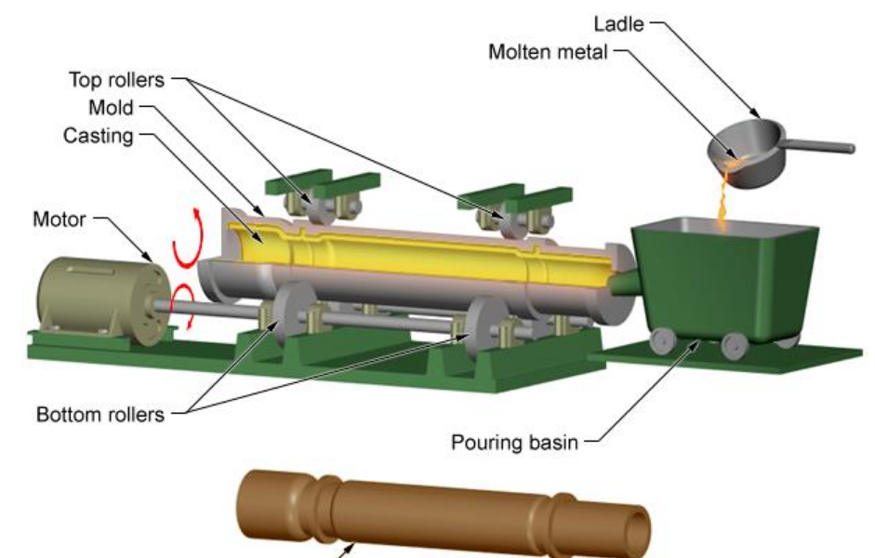
Centrifugal casting

Slide 13
Centrifugal casting
Process:
Molten metal is introduced into a rotating metal die,
metal, or graphite mould, and held against the mould wall by centrifugal force until it is solidified
A mold is set up and rotated along a vertical (rpm is reasonable), or horizontal (200‐1000 rpm is reasonable) axis.
The mold is coated with a refractory coating.
During cooling lower density impurities will tend to rise towards the center of rotation.

Slide 14
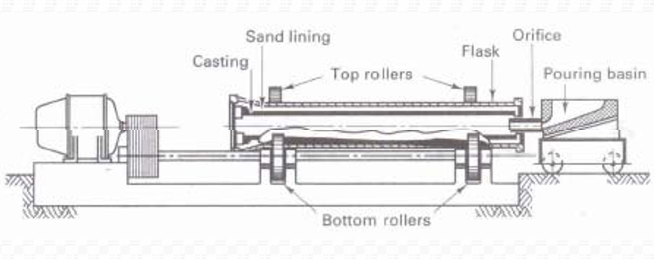
Centrifugal casting

Slide 15
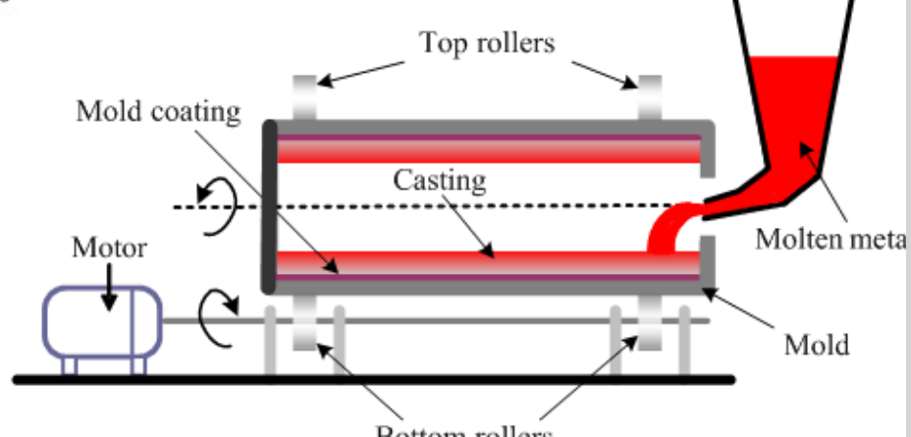
Centrifugal casting

Slide 16


